Slide 1
Modelling
Machine Learning

Slide 2
Introduction
Historically, computer programs have been rigid sets of rules.
Programs were designed to behave precisely as specified.
Example: Developing an e-commerce application with clear rules for user interactions, database management, and business logic.
Developers manually design automated systems.
Confidence in launching programs without seeing real customers.
Introduction to the idea that machine learning is not needed for such cases.
Examples of problems where manual coding is challenging:
Predicting tomorrow's weather.
Answering factoid questions.
Identifying people in images.
Recommending products to users.

Slide 3
What is Machine Learning
The study of algorithms that can learn from experience.
Improved performance with more experience, often in the form of data or interactions.
Contrast with deterministic systems that follow fixed logic.
Shift from coding specific rules to enabling programs to learn behaviors from labeled datasets. – Learning based approach
Programming with data.
"Programming" a cat detector by providing examples of cats and dogs.
The program learns to distinguish between cats and dogs based on the dataset

Slide 4
Key Components
Four Key Components are required
The data that we can learn from.
A model of how to transform the data.
An objective function that quantifies how well (or badly) the model is doing.
An algorithm to adjust the model’s parameters to optimize the objective function

Slide 5
1. Data & 2. Models
Data: Already covered in previous lectures
Models
Machine learning involves transforming the data
We might want to build a system that ingests photos and predicts smiley-ness.
To predict how normal vs. anomalous the readings are.
By model, we denote the computational machinery for ingesting data of one type, and spitting out predictions of a possibly different type.
In particular, we are interested in statistical models that can be estimated from data.

Slide 6
3. Objective Functions
Learning from experience.
using sets of data to train a computer to respond the way that a human brain would
The objective function is the function that summarizes what and how the programmers want the computer to learn.
Formal measures of how good (or bad) our models are. -- Optimization
lower is better. or higher is better (maximize profit and minimize cost)
Can be done by evaluating Loss Function
Loss Functions
Method of evaluating how well your machine learning algorithm models your featured data set.
Measurement of how good your model is in terms of predicting the expected outcome.
Must be minimized to get good results

Slide 7
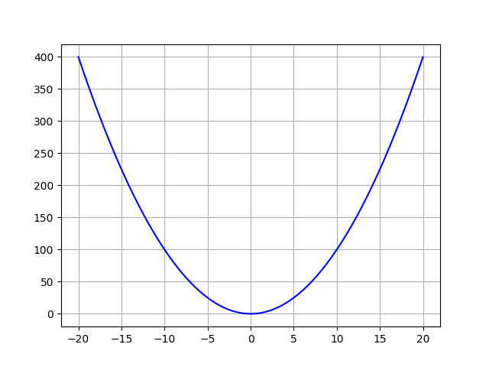
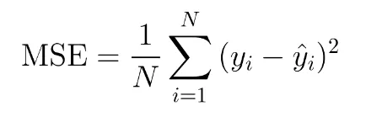
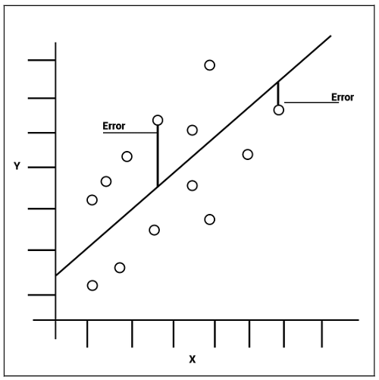
Loss Function
In REGRESSION, the most common loss function is mean squared error
the square of the difference between the prediction and the ground truth target.
taking the mean, of errors squared from data -- can never be negative
Larger MSE means data points are widely around the mean (of error)
Smaller is desirable – Better Estimator

Slide 8
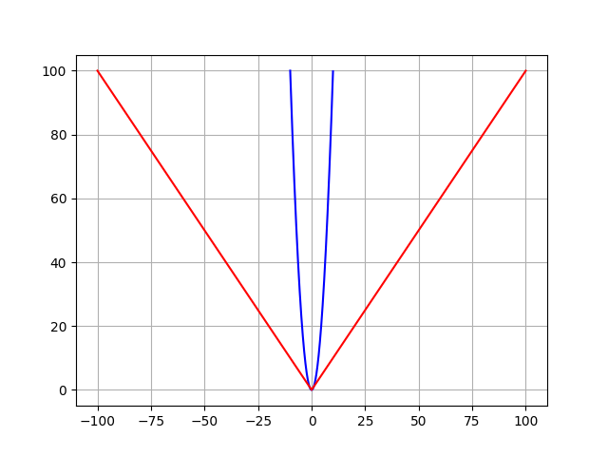

Loss Function
In CLASSIFICATION, the most common loss function is mean absolute error
the absolute of the difference between the prediction and the ground truth target.
taking the mean, of errors with absolute -- can never be negative
Unlike MSE, Outliers are given same weightage
Smaller is desirable – Better Estimator
MAE (red) and MSE (blue) loss functions

Slide 9
4. Optimization Algorithms
After data source, model, and objective function, we need an algorithm capable of searching for the best possible parameters for minimizing the loss function.
At each step, this method checks to see, for each parameter, how that training set loss would change if you perturbed that parameter by just a small amount. It would then update the parameter in the direction that lowers the loss. After each iteration:
compare the output with expected results,
assess the accuracy, and
adjust the parameters if required.
This is a repeated process. Can be done manually or use one of the many optimization techniques

Slide 10
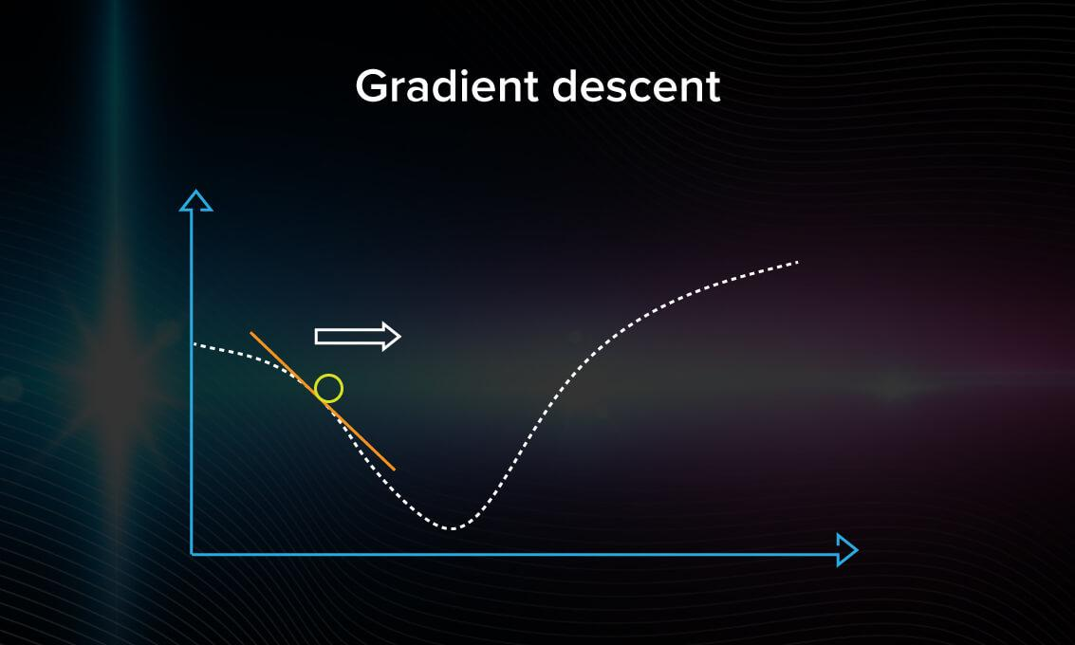
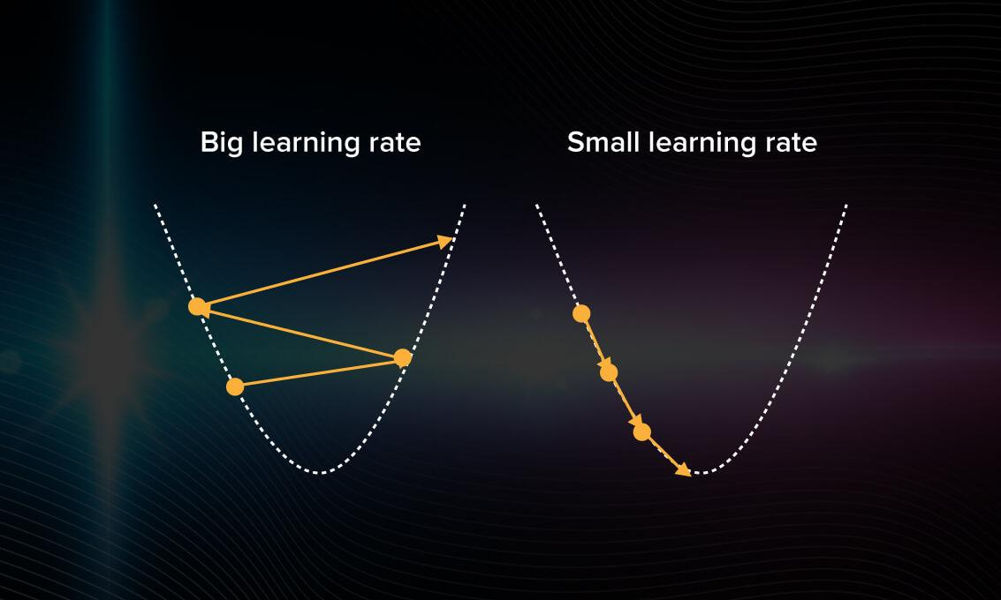
Optimization Technique
Exhaustive Search – Check all options one by one
Gradient Descent
iterate over the training dataset while re-adjusting the model.
Shows how the gradient descent algorithms travels in the variable space
take a random point on the graph and arbitrarily choose a direction.
If the error is getting larger, that means direction is wrong.
no improvement (decrease the error) means the optimization is over

Slide 11
Kinds of Machine Learning
Supervised Learning
Unsupervised Learning

Slide 12
1. Regression
Already discussed in previous lectures
The goal is to produce a model whose predictions closely approximate the actual label values.
A good rule of thumb is that any how much? or how many? problem is likely to be regression. For example:
How many hours will this surgery take?
How much rainfall will this town have in the next six hours?

Slide 13
2. Classification
Lots of problems do not fit comfortably in Regression.
A bank that wants to develop a check scanning feature for its mobile app. Customer would simply snap a photo of a check and the app would automatically recognize the text from the image.
to determine which character among some known set is depicted in each image patch. → which one? Type of problems are called classification and require a different set of tools from those used for regression
In classification, we want our model to look at features, e.g., the pixel values in an image, and then predict to which category (class) it belongs.
For handwritten digits, ten classes, 0 through 9.
The simplest form of classification is when there are only two classes, binary classification.
images of animals and need to be classified as {cat, dog}.
In regression we sought a regressor to output a numerical value
In classification we seek a classifier, whose output is the predicted class assignment.

Slide 14
Classification (2)
It can be difficult to optimize a model that can only output a firm categorical assignment, e.g., either “cat” or “dog”.
Better to express our model in the language of probabilities.
Given features of an example, model assigns a probability to each possible class.
a classifier might see an image and output the probability that the image is a cat as 0.9.
Classifier is 90% sure that the image depicts a cat.
The magnitude of the probability for the predicted class conveys a notion of uncertainty.
Can also have multiclass classification
Handwritten Caharacter Recognition {0, 1, 2, …, 9, a, b, c, …}

Slide 15

3. Tagging
What if the classifier encounters this image! featuring four animals along with trees in the background.
Multiclass classification alone may not give solution
we might want to give the model the option of saying the image depicts a cat, a dog, a donkey, and a rooster.
The problem of learning to predict classes that are not mutually exclusive is called multi-label classification.
May draw on enormous label sets.
Need to employ many professional annotators
A time-consuming process

Slide 16
4. Search
Vast field of Information Retrieval where ranking on sets of items require.
Web Search
The goal is less to determine whether a particular page is relevant for a query, but rather which, among a set of relevant results, should be shown most prominently to a particular user.
First assign a score to every element in the set and then to retrieve the top-rated elements.
PageRank, in Google search engine, was an early example of such a scoring system.
The scoring provided by PageRank did not depend on the actual query.
identify the set of relevant candidates and then used PageRank to prioritize the more authoritative pages.
Nowadays, search engines use machine learning and behavioral models to obtain query-dependent relevance scores.

Slide 17
5. Recommender System
Related to search and ranking - to display a set of items relevant to the user.
The main difference is the emphasis on personalization to specific users
For instance, recommender system for movies, retail products, music, and news
In some cases, customers provide explicit feedback, communicating how much they liked a particular product
(e.g., the product ratings and reviews on Amazon, IMDb, or Goodreads).
In other cases, they provide implicit feedback,
e.g., by skipping titles on a playlist, which might indicate dissatisfaction or maybe just indicate that the song was inappropriate in context.
In the simplest formulations, these systems are trained to estimate some score, such as an expected star rating or the probability that a given user will purchase a particular item.
Given such a model, for any given user, we could retrieve the set of objects with the largest scores, which could then be recommended to the user.
May have Conceptual Flaws

Slide 18
Unsupervised Learning
In supervised learning, we feed the model a giant dataset containing both the features and corresponding label values.
Map it with the analogy of supervised learner having an extremely specialized job and an extremely dictatorial boss.
The boss stands over the learner’s shoulder and tells them exactly what to do in every situation until they learn to map from situations to actions.
Working for such a boss sounds pretty lame and pleasing such a boss is pretty easy.
Just recognize the pattern as quickly as possible and imitate the boss’s actions.
Considering the opposite situation, it could be frustrating to work for a boss who has no idea what they want you to do.
In Unsupervised Learning, boss might just hand you a giant dump of data and tell you to do some data science with it!
sounds vague because it is vague.
the type and number of questions we can ask is limited only by our creativity.

Slide 19
Unsupervised Learning Questions
Can we find a small number of prototypes that accurately summarize the data?
Given a set of photos, can we group them into landscape photos, pictures of dogs, babies, cats, and mountain peaks?
Given a collection of users’ browsing activities, can we group them into users with similar behavior?
Clustering.
Can we find a small number of parameters that accurately capture the relevant properties of the data?
The trajectories of a ball are well described by velocity, diameter, and mass of the ball.
Tailors have developed a small number of parameters that describe human body shape fairly accurately for the purpose of fitting clothes.
Principal Component Analysis.
Is there a description of the root causes of much of the data that we observe?
If we have demographic data about house prices, pollution, crime, location, education, and salaries, can we discover how they are related simply based on empirical data?
Causality

Slide 20
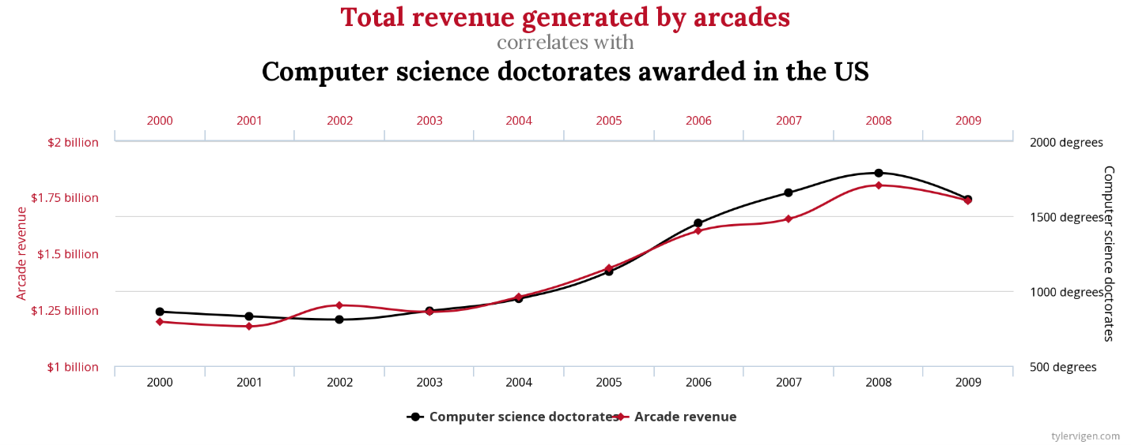
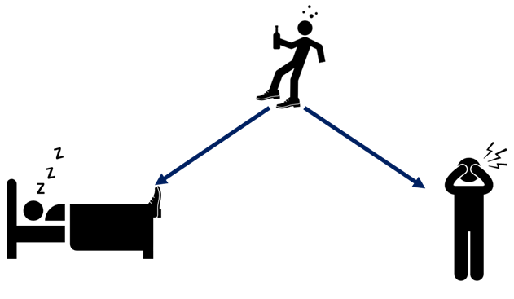
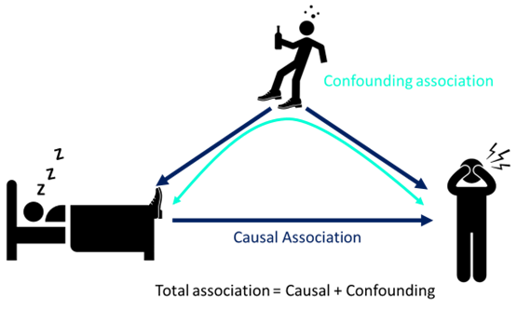
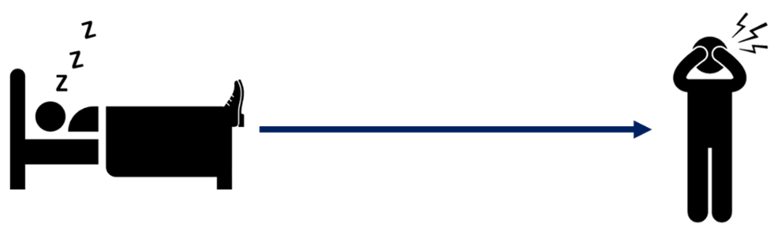
Causation Causal Inference Confounding Variables

